Slide 1

SARDAR VALLABHBHAI NATIONAL INSTITUTE OF TECHNOLOGY
Digital Communication Lab
Exp. No. 6
Digital Modulation Techniques
ASK, FSK and PSK

Slide 2
Digital Modulation Technique
Amplitude Shift Keying (ASK)
Frequency Shift Keying (FSK)
Phase Shift Keying (PSK)

Slide 3
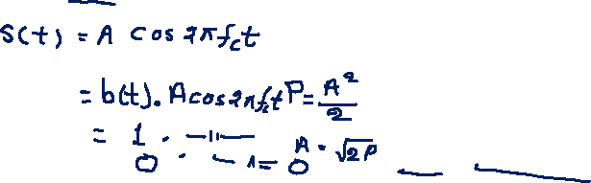
Amplitude Shift Keying
The ASK waveform may be represented as,
Unmodulated Carrier
NRZ Unipolar bit sequence
ASK waveform

Slide 4
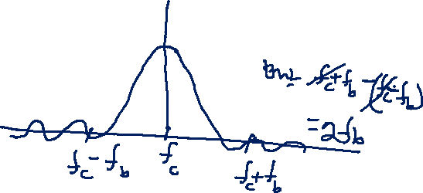
Advantages of ASK
It is easy to generate and detect.
Disadvantages of ASK
ASK technique is not suitable for high bit rate data transmission.
Poor bandwidth efficiency.

Slide 5
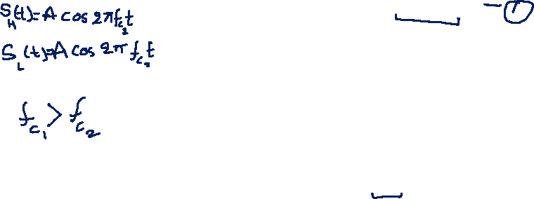
Frequency Shift Keying (FSK)

Slide 7
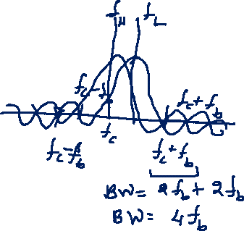
Advantages of FSK
Simple process to construct the circuit
Supports a high data rate.
Low probability of error.
High SNR (signal to noise ratio).
More noise immunity than the ASK
Error-free reception can be possible with FSK
Disadvantages of FSK
It requires more bandwidth than the ASK and PSK(phase shift keying)
Due to the requirement of large bandwidth, this FSK has limitations to use only in low-speed modems which the bit rate is 1200bits/sec.

Slide 8
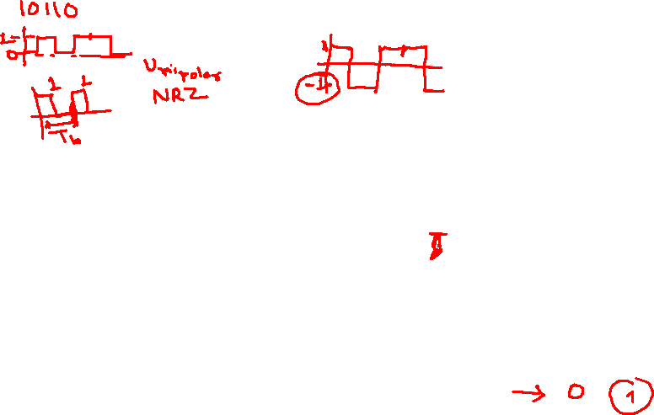
Phase Shift Keying (PSK)
The binary symbols ‘1’ and ‘0’ modulate the phase of the carrier. Let us assume that the carrier is given as,
s(t) = A cos (2pfct)
Now, when the symbol is changed, then the phase of the carrier will also be changed by an amount of 180 degrees (i.e., p radians). Let us consider, for example,
For symbol ‘1’, we have

Slide 9
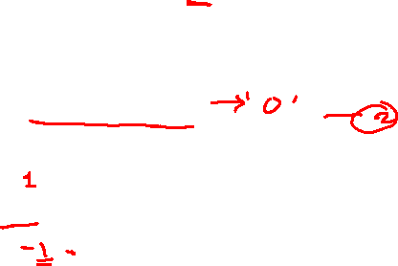
Phase Shift Keying (PSK)
If next symbol is ‘0’, then we have
For symbol ‘0’, we have
Now, because cos (θ + π) = – cos θ, therefore, the last equation can be written as,
With the above equation, we can define BPSK signal combinedly as,
b(t) = + 1 when binary ‘1’ is to be transmitted.
– 1 when binary ‘0’ is to be transmitted

Slide 10
Waveforms of PSK

Slide 11
Advantages of PSK
BPSK has a bandwidth which is lower than that of a BFSK signal.
BPSK has the best performance of all the three digital modulation techniques in presence of noise. It yields the minimum value of probability of error.
Binary phase shift keying (BPSK) has a very good noise immunity.
Disadvantages of PSK
The binary data is decoded by estimation of phase states of the signal. These detection and recovery algorithms are very complex.

